Slide 1

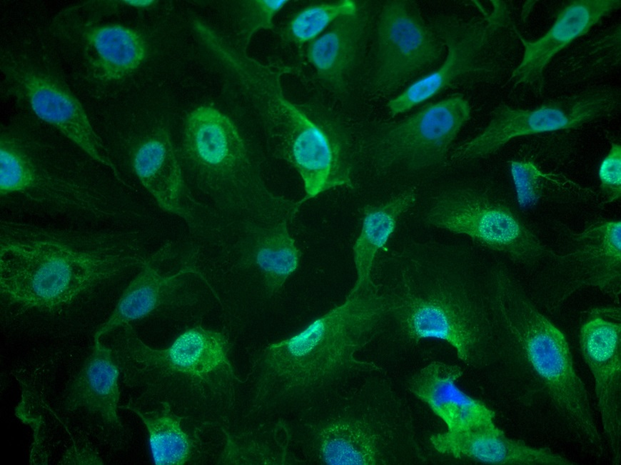
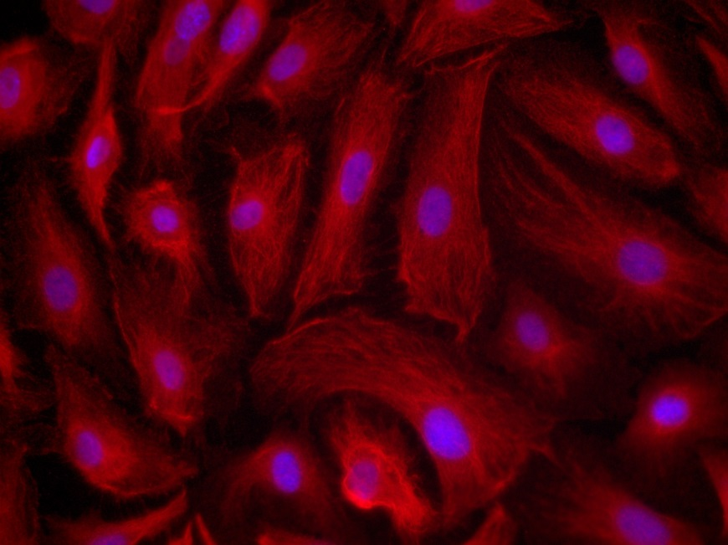
ReliaTech GmbH
Mouse anti-human Podoplanin (#101-M40-FITC / 101-M40-PE)
Immunofluorescence staining of human Podoplanin in primary human dermal lymphatic endothelial cells (HDLEC) using the monoclonal mouse anti-human Podoplanin-FITC (Cat #101-M40-FITC) [Left panel] and mouse anti-human Podoplanin-PE (Cat #101-M40-PE) [right panel].
.
http://www.reliatech.de / orders@reliatech.de

